Slide 1
Bad actors preliminary results

Slide 2
Pilot

Slide 3








Bad actors’ pilot
The pilot has been carried out on June, the 23-th, 2016.
During the pilot, we acquired hundreds of followers, and retweeters within Twitter from crowdturfing sites.

Slide 4



Bad actors’ pilot (cont.)
Eventually, we were able to acquire 4,160 users who followed our users, or retweeted our posts.
We defined these users as crowdturfers because they boosted our posts, and users. We paid for them in order to receive their influence.
From 4,160 bad actors:
444 users were found via VICO‘s feed.
All the others (3,716 users) are defined also as bad actors, but VICO‘s feed did not retrieve them.

Slide 5
Data collection

Slide 6
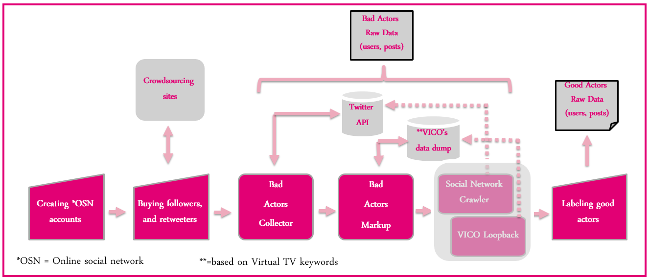
Data collection – short summary

Slide 7
Data collection
Total bad actors = 4,160
Bad actors NOT VICO users = 3,716
Bad actors VICO users = 444
VICO NOT Twitter users (Blogs, Forums) = 3,913
Users crawled by Twitter API NOT VICO
VICO
Users crawled by VICO = 13,251
VICO Twitter users = 9,338;
VICO Twitter users not suspended = 9,255
Good actors Not VICO users
Good actors VICO users
Suspended or not existing VICO Twitter users = 83
Notes:
--get all users crawled from VICO
SELECT *
FROM authors
WHERE authors.xml_importer_insertion_date IS NOT NULL
--get all Twitter users crawled from VICO
SELECT *
FROM authors
WHERE authors.xml_importer_insertion_date IS NOT NULL
AND authors.domain = "Microblog"
--get all NOT Twitter users crawled from VICO
SELECT *
FROM authors
WHERE authors.xml_importer_insertion_date IS NOT NULL
AND authors.domain is NOT "Microblog"
--get all VICO users suspended or not existing
SELECT *
FROM authors
WHERE authors.xml_importer_insertion_date IS NOT NULL
AND authors.domain is "Microblog"
AND authors.author_twitter_id IS NULL
--get all bad actors
SELECT *
FROM authors
WHERE authors.domain is "Microblog"
AND authors.author_type = 'bad_actor'
--get all bad actors VICO users
SELECT *
FROM authors
WHERE authors.xml_importer_insertion_date IS NOT NULL
AND authors.domain is "Microblog"
AND authors.author_type = 'bad_actor'
--get bad actors NOT VICO
SELECT *
FROM authors
WHERE authors.xml_importer_insertion_date IS NULL
AND authors.author_type = 'bad_actor'
--get all users crawled from TwitterAPI not VICO
SELECT *
FROM authors
WHERE authors.xml_importer_insertion_date IS NULL
AND authors.author_twitter_id IS NOT NULL
AND authors.domain = 'Microblog'
--get all VICO Twitter users not suspended
SELECT *
FROM authors
WHERE authors.xml_importer_insertion_date IS NOT NULL
AND authors.author_twitter_id IS NOT NULL
AND authors.domain = "Microblog"

Slide 8



Analysis Twitter authors retrieved from VICO
For the analysis we used the 9,255 Twitter authors who were retrieved via VICO’s feed and are not suspended.
We ran the DataSet Builder app for finding different features in order to distinguish between the authors.
VICO
Machine Learning Classifiers

Slide 9
Unsupervised learning

Slide 10
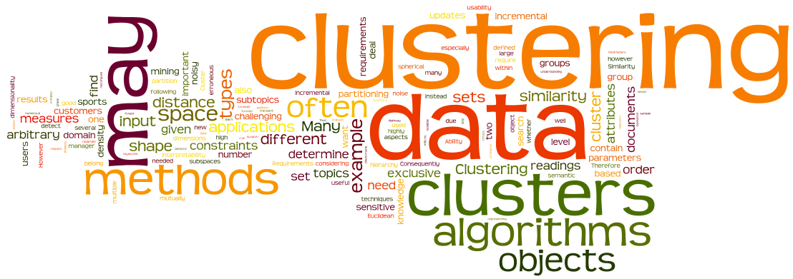
Unsupervised learning
To better understand the nature of the Twitter authors retrieved from VICO’s feed, we manually investigated them via cluster analysis.
We used unsupervised learning algorithm to divide authors into clusters
Authors in the same cluster share mutual features.

Slide 11
Cluster analysis
We used the Expectation-Maximization (EM) algorithm, and a set of features for representing each Twitter author to find groups of Twitter users who share similar appearances or behaviors.
Eventually, we were able to find 4 clusters:
% Bad actors | #Bad actors | Total | Clusters | No.
3.95% | 193 | 4886 | Cluster0 | 1
0% | 0 | 770 | Cluster1 | 2
8.127% | 244 | 3002 | Cluster2 | 3
1.172% | 7 | 597 | Cluster3 | 4
 | 444 | 9,255 |  | Sum

Slide 12
Cluster0 (main features)
This cluster is varied so it is hard to tell exactly which users exist in this cluster.
Several users advertise commercials via RT, and follow.
These users are probably crowdturfers.
Most of them are 3+ years old.
Low post per day – may be human.
2 times more following than followers.
#posts | #followers | #friends | FF ratio | Saved default profile | Posts per day | Post length | Age in days | Cluster
21,837.6 | 744.11 | 969.29 | 2.7026 | 43.99% | 25.085 | 14.0331 | 1370.58 | Cluster0
135,379.1 | 21,749.65 | 4,233.5 | 0.6596 | 39.01% | 250.4533 | 14.4654 | 1377.78 | Cluster1
148.78 | 4.44 | 192.14 | 59.33 | 99.83% | 5.26 | 10.7712 | 18.54 | Cluster2
20,938.17 | 315.889 | 733.05 | 7.187 | 68.2% | 60.1778 | 14.61 | 920.91 | Cluster3

Slide 13
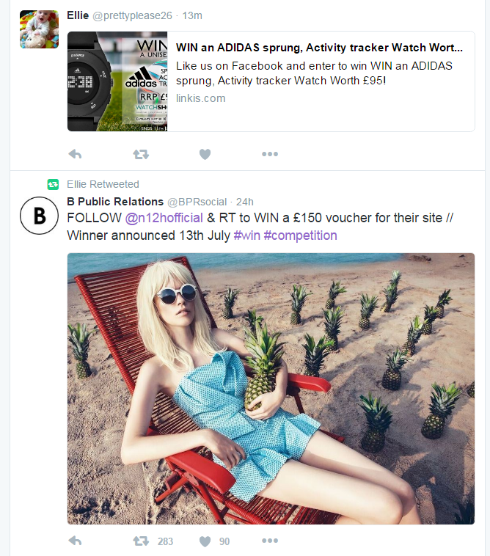
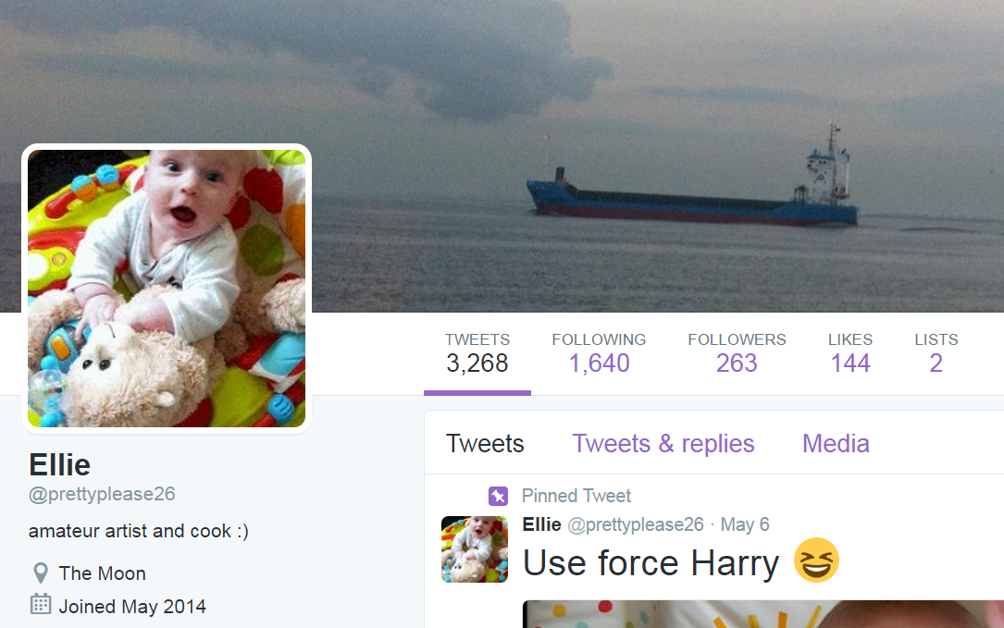
Cluster0 (observing manually)

Slide 14


Cluster1 (Observing manually)
This cluster includes many regular users who gained great effect within Twitter as well as companies, and news feed
They have great number of followers, and friends.
They publish great number of posts.

Slide 15
Cluster1 (main features)
Most of them are 3+ years old.
High number of posts per day – very active users
39% stayed with default profile. Most of them changed from default profile.
More followers than following.
#posts | #followers | #friends | FF ratio | Saved default profile | Posts per day | Post length | Age in days | Cluster
21,837.6 | 744.11 | 969.29 | 2.7026 | 43.99% | 25.085 | 14.0331 | 1370.58 | Cluster0
135,379.1 | 21,749.65 | 4,233.5 | 0.6596 | 39.01% | 250.4533 | 14.4654 | 1377.78 | Cluster1
148.78 | 4.44 | 192.14 | 59.33 | 99.83% | 5.26 | 10.7712 | 18.54 | Cluster2
20,938.17 | 315.889 | 733.05 | 7.187 | 68.2% | 60.1778 | 14.61 | 920.91 | Cluster3

Slide 16
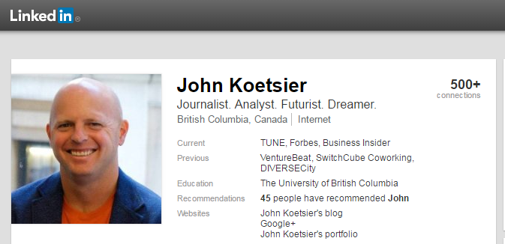
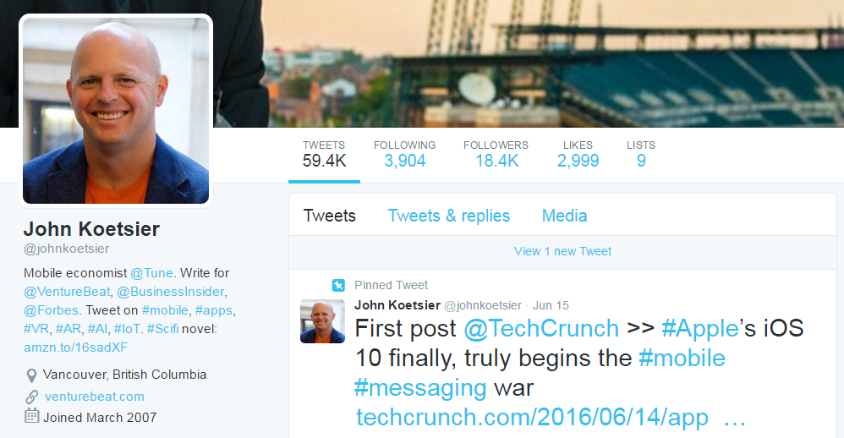
Cluster1 (Observing manually)
Several found to be regular users.
Many of them were found in other OSNs.

Slide 17

Cluster2 (Observing manually)
This cluster includes many users which are suspected to be newly profiles of socialbots.
Most of them are not include too much information regarding themselves, simple default users, unrecognizable profile images.
Many of them have small number of posts, as well as followers.
Despite the small number of posts published by them, their most prominent activity is retweeting others’ posts. Probably as part of advertising campaigns.

Slide 18
Cluster2 (main features)
Most of them are 18 days old. Extremely young.
Very low number of posts per day
99% stayed with default profile (simple bots).
59 times more follow other users than other users follow them.
Extremely small number of followers, friends, and posts.
#posts | #followers | #friends | FF ratio | Saved default profile | Posts per day | Post length | Age in days | Cluster
21,837.6 | 744.11 | 969.29 | 2.7026 | 43.99% | 25.085 | 14.0331 | 1370.58 | Cluster0
135,379.1 | 21,749.65 | 4,233.5 | 0.6596 | 39.01% | 250.4533 | 14.4654 | 1377.78 | Cluster1
148.78 | 4.44 | 192.14 | 59.33 | 99.83% | 5.26 | 10.7712 | 18.54 | Cluster2
20,938.17 | 315.889 | 733.05 | 7.187 | 68.2% | 60.1778 | 14.61 | 920.91 | Cluster3

Slide 19
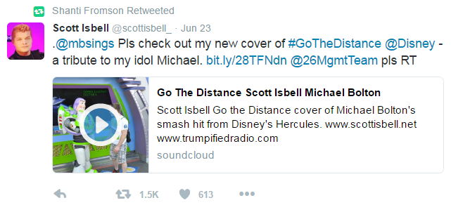
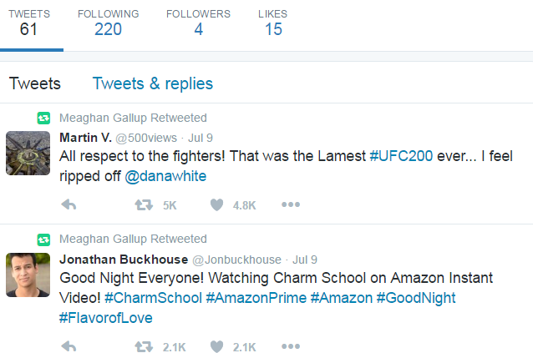
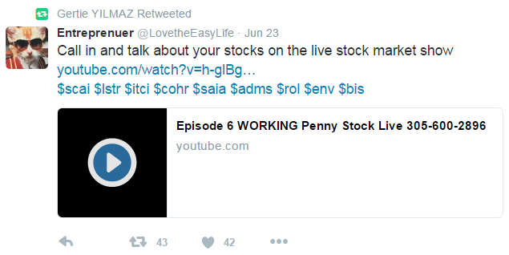
Cluster2 (Observing manually)

Slide 20
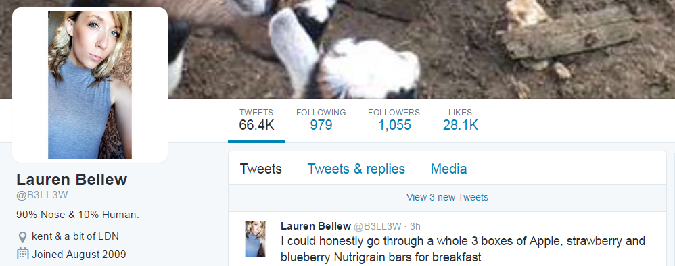

Cluster3 (Observing manually)
This cluster focuses on the great number of posts published by the users.
Some of them are found to be regular users who published posts all day long.

Slide 21

Cluster3 (Observing manually)
Some of them were found to be merchandize promoters, which were created by merchandizers for promoting their goods.

Slide 22

Cluster3 (Observing manually)
Some of them were found to be crowdturfers, which published many posts for boosting others.

Slide 23
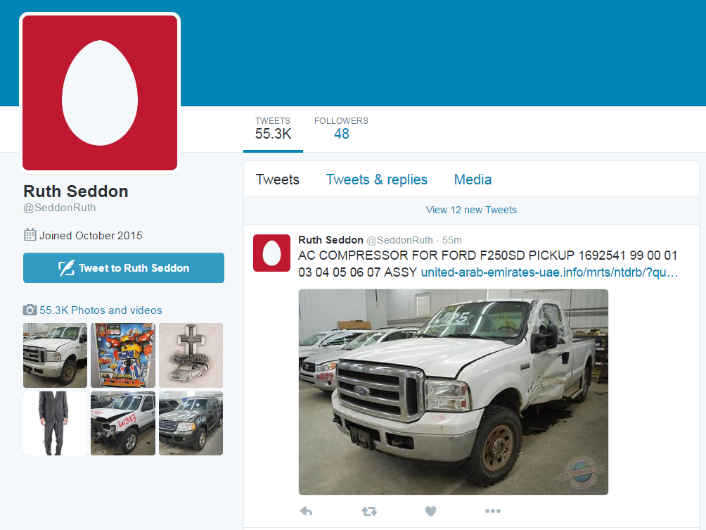
Cluster3 (Observing manually)
Some of them were found to be bots, which published many posts for varied reasons.

Slide 24
Cluster3 (main features)
Most of them are about 2.5 years old.
7 times more following than follow.
Great number of posts in opposed to number of followers, and friends.
#posts | #followers | #friends | FF ratio | Saved default profile | Posts per day | Post length | Age in days | Cluster
21,837.6 | 744.11 | 969.29 | 2.7026 | 43.99% | 25.085 | 14.0331 | 1370.58 | Cluster0
135,379.1 | 21,749.65 | 4,233.5 | 0.6596 | 39.01% | 250.4533 | 14.4654 | 1377.78 | Cluster1
148.78 | 4.44 | 192.14 | 59.33 | 99.83% | 5.26 | 10.7712 | 18.54 | Cluster2
20,938.17 | 315.889 | 733.05 | 7.187 | 68.2% | 60.1778 | 14.61 | 920.91 | Cluster3

Slide 25
Next steps

Slide 26
Labeling good actors

Slide 27
Data collection – short summary

Slide 28
Labeling good actors
In order to use supervised learning methods for studying users we have to gain a list of labeled good actors.
In these days we define descriptive rules for labeling good actors manually.
We will take the users from Cluster1, which we suspect to be regular users.
We will use the Committee of Experts method in order to confirm which users from Cluster1 are in fact good actors.
Every member of BGU team will label authors according to the rules that will be determined.
A user will be labeled as good actor when all the members agreed on its identity.

Slide 29






Supervised authors classification
Create labeled dataset
VICO
Train Machine Learning Classifiers
Test classifiers on real data operated by CRM

